Slide 1
Programming Assignment-3 (Chapter 4, Question 10)
Mohamed farhan

Slide 2
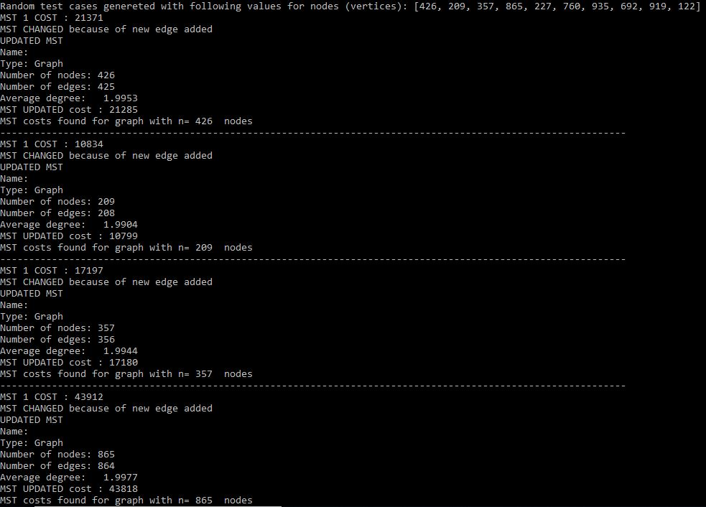
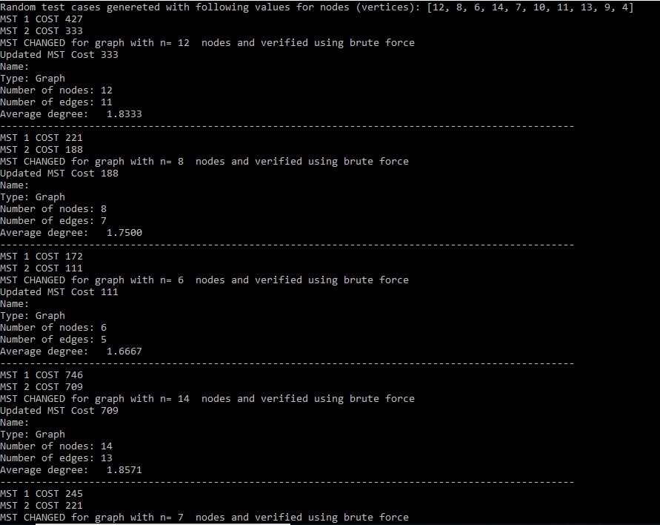
Results obtained for randomly generated test cases (left) and brute force technique (right)

Slide 3
Pseudocode
Generate 10 random test cases with n nodes for a graph.
Create a graph G using networkx library.
graph=nx.cycle_graph(5)
Determine the minimum spanning tree (MST) T and its cost.
Add an edge e=(u,v) with weight w in G
graph.add_edge(1,5,weight=1)
Find the cycle C formed by adding the new edge e=(u,v) to T
Find the edge e* in cycle C that has maximum weight w*
Is w < w*
If yes, then new MST T*=T-e*+e is the MST for graph G+e
If not, then T*=T is the MST of G+e

Slide 4
Validation of correctness of randomly generated test cases (n=1,2….15)

Slide 5
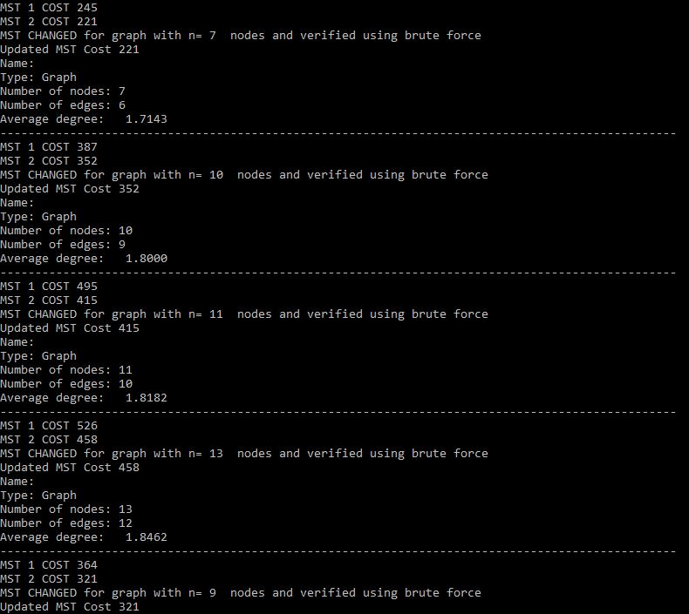
Validation of correctness of randomly generated test cases (n=1,2….15)(Continuation)

Slide 6
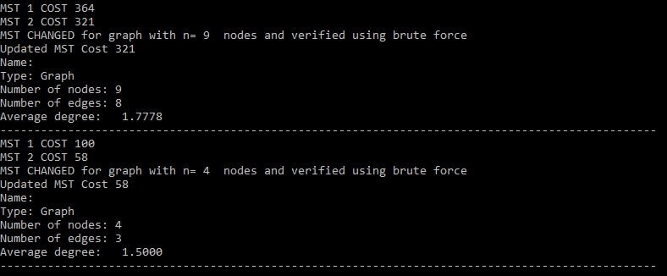
Validation of correctness of randomly generated test cases (n=1,2….15)(Continuation)

Slide 7
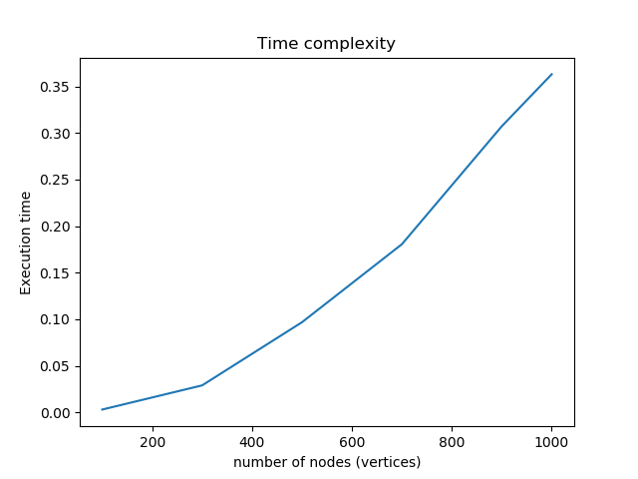
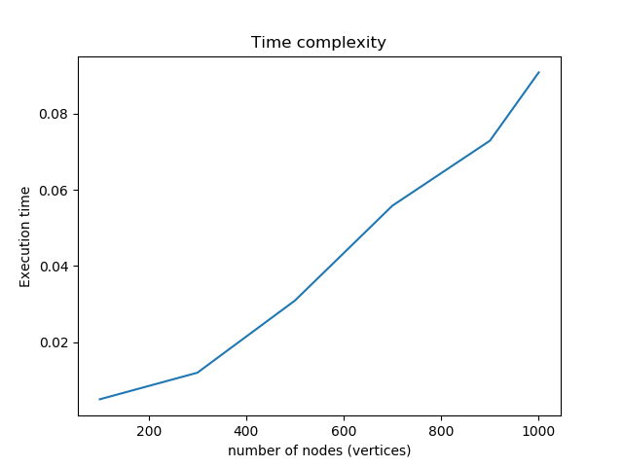
Validation of performance
Time complexity to check if current MST has been updated after adding new edge to graph G is O(|V|) where |V| is the number of nodes (vertices)
Time complexity to update old MST is O(|V|) where |V| is the number of nodes (vertices)

